Slide 1
Embedded Edition
N.N.
NN@qt.qio
February 2017 – Based on Qt 5.5

Slide 2
Contents
Qt Embedded | Embedded Configurations, Feature Management, Memory Footprint, Embedded Tool Chains, Yocto Project, Cross-Compilation, Deployment
Qt GUI Integration | QPA Plugin, Screen, Window, Backing Store, and GL Context, GUI Event System Integration, Integration Classes, Themes
Qt Enterprise Virtual Keyboard | Usage, Customization
Qt Serial Bus | Serial Bus Usage, Backends
Boot2Qt | Boot2Qt, Embedded App Creation, Building, Debugging, and Deployment, Build System Customization

Slide 3
Objectives
To learn essential Qt libraries for application engine development
Qt programming on embedded targets
Qt Enterprise Embedded AKA Boot2Qt
Any questions at any point – please do not hesitate to ask!

Slide 4
Qt Embedded

Slide 5
Contents
Embedded Configurations
Feature Management
Memory Footprint
Embedded Tool Chains
Yocto Project
Cross-Compilation
Deployment

Slide 6
Qt Embedded
Prior Qt5, Qt Embedded was based on Qt Window System (QWS)
Since Qt5, no Qt-specific window system
New compositor Technology Preview in Qt 5.6
Qt Embedded means building Qt to embedded targets
Some platforms require more adaptation than others
No Posix APIs
No processes

Slide 7
Building Qt Libraries for Embedded Platforms
Create a target toolchain
Target image and rootfs created as well
Configure Qt
Write/edit platform-specific MKSPECS-file
Configure required features, add/remove features
Build Qt libraries using the target tool chain
Deploy Qt libraries to your target device
Boot2Qt helps in all phases
Provides pre-built target image, Qt libraries, and tool chain
Just deploy the target image and start developing Qt programs

Slide 8
1. Create a Target Toolchain
Package to cross-compile Linux + Qt libraries + other SW to the embedded target
Cross-compiler, linker, possibly a debugger
Boot code (u-boot)
Root file system (rootfs) including
Linux kernel, Board Support Package (BSP) for the HW in question
Time consuming process
Build the toolchain tool with all the dependencies
Build the bootloader, kernel, and root file system with optimal configurations
Optimal configuration for the performance?
Optimal configuration for minimal memory footprint?
Silicon vendors may provide useful configurations for the HW platform

Slide 9
Embedded Toolchain
A tool to cross-compile SW in some host to the target board
Compiler, linker, assembler tool, C library
CodeSourcery – Eclipse-based IDE and GNU toolchain for numerous target architectures
Linaro – optimized toolchains for recent ARM CPUs (Cortex A8, A9) implemented partially by CodeSourcery employees
DENX Embedded Linux Development Kit (ELDK) – Cross compilation tools + U-Boot, Linux kernel + drivers for ARM, PowerPC, and MIPS processors
ScratchBox – toolchanis for x86 and ARM target architectures
Toolchain Building System
Build a toolchain from the sources and possibly build the whole target operating system ready to be flashed
Buildroot – complete build system, based on Linux kernel configuration system
Crosstool-NG – similar to Buildroot, targeting at easier configuration
Both toolchains support a wide variety of target architectures
Bitbake - tool to build the complete distribution (Ångström), used by OpenEmbedded

Slide 10
Linaro
Open organization focused on improving Linux on ARM
http://www.linaro.org/about/
Linaro Linux Kernel
Modern, optimized
Supports thumb instructions
Linaro Toolchain
GCC-based compiler, various versions of GCC supported
GDB
QEMU to run (emulate) ARM binaries

Slide 11
Crosstool-NG
Crosstool New Generation (NG)
http://crosstool-ng.org/
Tool to build toolchains from the scratch
Latest features and optimizations
The toolchain may be used to build the root file system (buildroot tool)
Support for, e.g. Linaro toolchain
Well-known kernel like menuconfig interface to select the configuration (target settings, compiler configuration, glib, Qt libraries etc.)
Though easy to configure, embedded developer must know what to do
What are the latest SW packages (may be needed to setup and configure manually)
What is the right toolchain configuration to use? All toolchains do not support hard floating points, for example

Slide 12
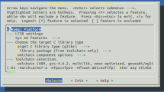
LTIB – Linux Target Image Builder
Open source project for creating Linux BSPs and images maintained at Savannah
http://savannah.nongnu.org/projects/ltib
BSP (Board Support Packages)
HW-specific boot and driver code
Concept similar to Buildroot
To build the root file system
Over 200 packages and BSPs for Freescale CPUs
For iMX6 (ARM), uses Linaro toolchain
First, may be time consuming to setup but then rather easy to use
Hard coded paths in Perl scripts (need to be fixed)
Out of the date packages – need to update by manually editing repo references, e.g. Qt 5.x libraries

Slide 13
Open Embedded Project
Open source project, providing tools to build a complete Linux distribution for embedded systems
http://www.openembedded.org
Over 1,000 packages
Based on the layers on the top of OE-Core
Base layer for recipes (details of pieces of SW), classes (build info) and other files (configurations)
More than 7,500 recipes exist covering 300 machines and 200 distros
Support for ARM, x86, x86-64, PowerPC, and MIPS
Distro-less, though standalone image may be built
Split out from Poky distro (Yocto project)
Another layer meta-openembedded
Contains items shared by multiple layers, but do not fit into the OE-Core

Slide 14
Ångström
Distro on top of oe-core and meta-openembedded
http://www.angstrom-distribution.org
Very small minimum memory footprint 4MB
Compare to Qt core and GUI libs, which alone have approximately the same size
The buildsystem uses various components from Yocto
Bitbake cross-compiler
Application and BSP layers
Widely used on TI-based embedded boards, like BeagleBoard and PandaBoard

Slide 15
Yocto Project
Open source project and Linux Foundation workgroup, providing templates, tools, packages and so on to create embedded Linux distros
https://www.yoctoproject.org
Open source build system and toolchain called Poky
OE-Core is one Poky branch
Automates the fetch of source packages
No script updating
Package details defined in recipes
Recipes easy to add and replace
Package format and architecture agnostic
Core build tool (Bitbake) and metadata syntax shared with Open Embedded project
Used by Qt Enterprise Embedded

Slide 16
Yocto Development Environment
Yocto metadata
Metadata (.bb and patches)
BSPs (machine configs)
User configs
Policy configs
Source Fetching
Patch Application
Configuration, compile
Sources
Upstream project releases
Local projects
Package Generation
.rpm
.deb
.ipk
QA Tests
Image Generation

Slide 17
Yocto Toolchain Practical Steps High-Level Description
Step 1: Get Yocto
$ git clone git://git.yoctoproject.org/poky
$ cd poky
$ git checkout -b dizzy origin/dizzy
Step 2: Initialize the build environment
$ source oe-init-build-env buildDir
Creates, e.g. conf/bblayers.conf and conf/local.conf
The first file defines the layers used
The latter one defines user configuration
Step 3: Configure the local.conf file
Located in the build folder
Look at the reference documentation for syntax and variables
For example, define your target platform MACHINE ?= “beaglebone”
Step 4: Create the image
$ bitbake core-image-minimal
May take several hours

Slide 18
Layers (OE-Core)
Layers define the SW packages you want to include into your image
Define the layers you wish to use in your build folder conf/bblayers.conf file
Download or create new layers
E.g. for toradex from git://git.toradex.com/meta-toradex.git
Look at examples at Qt Enterprise Embedded folder <installation folder>/Boot2Q/sources/b2qt-yocto-meta
Layers contain
Recipes
Configuration
Classes
Some example layers
openembedded-core
BSPs
meta-fsl-arm
meta-raspberrypi
Distros
meta-angstrom
meta-yocto (Poky)
SW
meta-gstreamer10
meta-go, meta-java
Misc
meta-linaro

Slide 19
Configuration
Configuration files (*.conf)
Define variables used by build scripts (recipes)
Compare to qmake variables, some similarities in the syntax (shell-like)
DISTRO ?= “poky”
Look at the syntax details in Yocto reference manual and usage details in the sample files
Configuration files
User configuration – local.conf
Build configuration – bitbake.conf
Machine configuration – emulator.conf
Distro configuration – b2qt.conf

Slide 20
Bitbake Classes
Classes (*.bbclass)
Provide information, which is useful to share between recipes
Define the configuration scripts
Refer to variables in configuration files
For example, how to configure generic recipe agnostic tests

Slide 21
Recipes
Provides details about particular pieces of SW (*.bb)
Local and remote repositories
Patches
Configuration
Build scripts
Package options (.deb, .rpm, .idk)
Provides additional SW-specific variables and script functions
Used by Bitbake tool

Slide 22
Building
Targets are defined in recipes
Building itself straightforward
$ bitbake core-image-minimal
File core-image-minmal.bb found in poky/meta/recipes-core/images folder
The core-image-minimal version could be defined in distribution configuration options
Target may have additional features defined in the recipe file
A core image may for example include
Boot code
Qt libraries

Slide 23
2. Configure Qt
<QtSrc>/qtbase/configure is a tool for configuring/building Qt itself for the target platform
Creates Makefiles for the modules
Builds e.g. platform-specific tools: qmake, uic, rcc, moc
Can be used to manage Qt features / memory footprint of Qt libraries
Embedded configuration
configure –device <device name>
make module-qtbase
make install
Qt Source Code
Qt binaries for
the target platform
qmake
configure

Slide 24
Useful Configuration Options
-device <device name>
-device-option CROSS_COMPILE=<CROSS COMPILER PATH>
-sysroot <sysroot path>
-qpa // Default QPA platform
-prefix <dir>
-pch / -no-pch // Pre-compiled headers
-feature / -no-feature // -no-feature-accessibility
-opengl <api> // es1, es2
-qconfig <custom> // Custom configuration in src/corelib/global/qfeatures.txt
-shared / static
-debug / release // -separate-debug-info –force-debug-info
-qt-<library name> / -system-<library name>

Slide 25
Toradex Configuration – Made by Build Scripts
./configure
-commercial
-confirm-license
-release
-device linux-imx6-g++
-device-option CROSS_COMPILE=/toolcahin/sysrootfs/armv7ahf-vfp-neon-poky-linux-gnueabi/usr/share
-sysroot /toolcahin/sysrootfs/armv7ahf-vfp-neon-poky-linux-gnueabi
-no-xcb
-nomake examples
-nomake tests

Slide 26
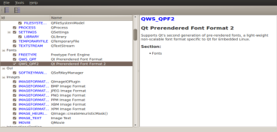
Managing Memory Footprint
Create a custom configuration
Simple way
-no-feature-<feature> | -feature-<feature>
/src/corelib/global/qfeatures.txt
/src/corelib/global/qconfig-<minimal/small/medium/large>.h
Or use qconfig tool
Located in /qttools/src/qconfig
Produces custom configuration file to configure Qt
Enable/disable features
Save under new name src/corelib/global/qconfig-myconfig.h
Run configure script with option -qconfig myconfig

Slide 27
Managing Memory Footprint
Executable compression
Ultimate Packer for eXecutables- http://upx.sourceforge.net/
Obviously, there is a small performance trade-off for decompression
Compilation options
Remove speed optimizations: QMAKE_CXXFLAGS_RELEASE -= O2
Enable size optimizations: QMAKE_CXXFLAGS_RELEASE += Os
Do not forget to strip your final binaries

Slide 28
Cross-Compilation Configuration
If needed, create a target-specific make specification in the folder <Qt src>/qtbase/mkspecs
Use a specification close to your platform (e.g., mkspecs/linux-arm-gnueabi-g++)
Sometimes provider by the chip vendor
It is essential to define cross-compiler tools and build flags (qmake.conf)
QMAKE_CFLAGS = -march=armv7-a -mfpu=neon -mfloat-abi=softfp QMAKE_CXXFLAGS = -march=armv7-a -mfpu=neon -mfloat-abi=softfp QMAKE_CC = arm-fsl-linux-gnueabi-gcc QMAKE_CXX = arm-fsl-linux-gnueabi-g++ QMAKE_LINK = arm-fsl-linux-gnueabi-g++ QMAKE_LINK_SHLIB = arm-fsl-linux-gnueabi-g++ # modifications to linux.conf QMAKE_AR = arm-fsl-linux-gnueabi-ar cqs QMAKE_OBJCOPY = arm-fsl-linux-gnueabi-objcopy QMAKE_STRIP = arm-fsl-linux-gnueabi-strip load(qt_config)

Slide 29
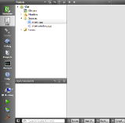
3. Build Qt Libraries
Qt Project
qmake
[Linux/X11]
Makefile
App
in
Linux
GCC
[Linux compiler]
Qt/C++
code files
.pro
file
Qt/C++
code files
Qt/C++
code files
qmake
[Embedded Linux]
Makefile
Cross compiler
App
in
Target HW
qmake
[INTEGRITY]
.gpj
MULTI
App
in
Target HW
Other IDE / Code Editor
Native tool chains
Qt Creator

Slide 30
4. Deployment – The Target Has Qt Libs
The target platform has Qt libraries
Use INSTALLS variable in the .pro file to install any files
Use QCoreApplication::addLibraryPath()/setLibraryPaths() to add search path for plugins
target.files = someFille *.qml qml.dir
installDestination = $$[QT_INSTALL_QML]/MyModule/SubName
target.path = $$installDestination
INSTALLS += target

Slide 31
How to detect Qt version installed on the target?
qmake –v
Qt include folder
Platform dependent tools
Linux: ldd
macos: otool
Windows: Dependency Walker (depends - http://www.dependencywalker.com)

Slide 32
Deployment – The Target Does not Have Qt Libs
Create a static build
configure –static –platform
Create a bundle manually
Copy the relevant Qt libs/plugins to your bundle
Write a script which sets relevant environment variables and launches your application
#!/bin/sh
export LD_LIBRARY_PATH=`pwd`/qt_libs
export QML2_IMPORT_PATH=`pwd`/qt_libs/qml
export QT_QPA_PLATFORM_PLUGIN_PATH=`pwd`/qt_libs/plugins/platforms
./MyCoolApplication

Slide 33
Deployment – The Target Does not Have Qt Libs
Use platform-dependent (OSX, Windows) deployment tools in QTDIR/bin
macdeployqt, windeployqt
Some options
-no-plugins (by default all release plugins will be added, if the corresponding Qt module used)
-dmg create a disk image in OSX
Third party libraries must still be manually copied to the bundle/added to the installation package
You may need to handle different architectures 32/64 bit, Intel/PowerPC etc.
Create a custom binary installer
Used e.g. for the Qt SDK installers, and Qt Creator installer
Customizable
Offline or online

Slide 34
Creating Custom Installer
Create a package directory structure
Create a configuration file
Create a package information file
Create installer content and copy it to the package directory.
Use the binarycreator tool to create the installer
The installer pages are created by using the information you provide in the configuration and package information file

Slide 35
Qt GUI Integration Platform Abstraction

Slide 36
Contents
Platform Abstraction
Screen, Window, Backing Store, GL Context
GUI Events
Essential QPA classes
Themes

Slide 37
Qt (Embedded) Native Integration
Prior Qt5, Qt Embedded was based on the lightweight window system called QWS
Replacing “heavy” X11 originally
In Qt 5, QWS has been replaced by QPA – Qt Platform Abstraction, introduced in Qt 4.8
Not a window system, just a platform abstraction
Other integrator related issues
CPU architecture
Atomic operations
Operating System
Requires libc, pthread, some math functions
QtCore runs well on a POSIX compliant OS/RTOS
Qt APIs
Qt/Embedded
QWS
QPA
Display
Keyboard
Mouse
OpenGL
Wayland
EGL
OpenGL
QWS
Drivers
QPA
Plugins
OS Services
HW

Slide 38
QWS vs. QPA
Qt Embedded is a lightweight window system
Applications write to the shared memory and QWS server composites the buffers
Supports multiple processes and windows
One process provides QWS server
Uses plug-ins (drivers) to manage input devices and screen output
Controls screen cursor appearance and screen saver
Hub for inter-process communication
OpenGL-based acceleration is not always easy
PowerVR reference plugin exists
QPA is not a window system
A single platform dependent plug-in
DirectFB, LinuxFB, EGL, XCB, Windows, WinRT, iOS, Android, QNX, VxWorks
Full OpenGL support
Platform-specific window-system may be used
Or a plug-in may provide the window system (Wayland compositor)

Slide 39
Building and Using QPA Plugin
Default QPA plugin may be define in configuration
-qpa eglfs
The default platform may be replaced in run-time
Use the –qpa command line option or
Define the QT_QPA_PLATFORM environment variable
Default QPA plugins
XCB for Linux
Windows for Windows
Cocoa for Mac
Platform initialized by the QGuiApplication
Uses QPlatformIntegrationFactory to load the QPA plugin (qLoadPlugin1())
The plugin uses QPlatformIntegrationPlugin to instantiate a QPlatformIntegration sub-class

Slide 40
EGLFS Plugin
Supports OpenGL ES and SW rendered windows on top of EGL without a windowing system
Recommended plugin for embedded Linux with GPU
Forces the first top-level window to be full screen
All other windows (dialogs, popup menus, drop-down windows) are composited to the top-level window
EGLFS supports exactly one native window and EGL window surface
Opening two OpenGL windows or mixing OpenGL and raster windows is not supported
If multiple windows are needed, you may use
Qt Wayland Compositor plugin

Slide 41
QPA High-Level Architecture
QPA plugin will be created by QGuiApplication
There are two main classes created
QPlatformTheme – theming support integration
QPlatformIntegration – window system integration
The platform integration class will also create a concrete, platform-dependent event dispatcher for GUI events
There exist ready made classes for event dispatching

Slide 42
Essential Classes
In Qt5, it is possible to paint using QWidget (a paint device) or QWindow
When the main widget (top-level window) is set visible, a QWindow object is created
Platform integration class creates a platform window
Windows are managed by QPlatformScreen, corresponding to QScreen class
The platform screen often manages GUI event handlers as well
The window is either a raster or OpenGL surface
A raster surface paints to a paint device using the backing store, which flushes the pixels to the frame buffer
An OpenGL surface uses a platform dependent QOpenGLContext

Slide 43
Paint Classes and Platform Classes

Slide 44
How to Start?
Select whether you want to have an accelerated QPA plugin or not
Acceleration support may be added later
Trivial example plugins
Raster - qtbase/src/plugins/minimal/
Accelerated - qtbase/src/plugins/minimalegl/
Plenty of ready-made code
qtbase/src/platformsupport/
Often it is enough to add or adjust the feature rather than implement a complete plugin from the scratch

Slide 45
Platform Support
Plenty of useful functions and classes as included projects (.pri)
Accessibility
Assistive Technology Service Provider Interface + DBus clients
Basic + font database .pri projects
Font database (accessed through the platform integration class)
Device discovery
Static and udev device manager based device discovery
EGL (+ GLX)
EGL-based GL context
Input
All input devices
Desktop services
openUrl()

Slide 46
Essentials Classes – QPlatformIntegration
Three pure virtual functions
QAbstractEventDispatcher *guiThreadEventDispatcher()
Concrete event dispatchers in the platform support folder
QPlatformWindow *createPlatformWindow(QWindow *window)
QPlatformBackingStore *createPlatformBackingStore(QWindow *window)
Capabilities
Threaded pixmaps (re-entrant pixmaps), threaded OpenGL (OpenGL support outside GUI thread), buffer queuing OpenGL (swapBuffers() does not immediately suspend the thread), window masks, multiple windows (windows composited)
Return true, if the capability is supported

Slide 47
Essentials Classes – QPlatformIntegration
Constructor
Instantiates platform screens
Add to the container using screenAdded() – can be accessed using QGuiApplication::screens()
Other functions
For deeper window integration

Slide 48
Input Handlers
Platform support input.pri
Mouse, keyboard, touch, tablet
Can be created anywhere: platform integration, screen, window
All input handlers share the same principles
Read events from the device API using file descriptors
You may find QT_OPEN and QT_READ macros useful
Use QSocketNotifier to read events asynchronously from the file descriptor
myNotifier = new QSocketNotifier(pointerFD, QSocketNotifier::Read, this);
QT_READ(pointerFD, bufPos, size);
Implement event data parsing in the notifier callback
Use QWindowSystemInterface API to add the event to Qt event queue

Slide 49
Example – Input Handlers
QEvdevTouchScreenHandler::QEvdevTouchScreenHandler(const QString &specification, QObject *parent) :
QObject(parent), m_notify(0), m_fd(-1), d(0)
{
QString dev; QScopedPointer<QDeviceDiscovery> deviceDiscovery(QDeviceDiscovery::create(
QDeviceDiscovery::Device_Touchpad | QDeviceDiscovery::Device_Touchscreen, this));
if (deviceDiscovery) {
QStringList devices = deviceDiscovery->scanConnectedDevices(); dev = devices[0];
}
m_fd = QT_OPEN(dev.toLocal8Bit().constData(), O_RDONLY | O_NDELAY, 0); if (m_fd >= 0) {
m_notify = new QSocketNotifier(m_fd, QSocketNotifier::Read, this);
connect(m_notify, SIGNAL(activated(int)), this, SLOT(readData()));
}
}
void QEvdevTouchScreenHandler::readData()
{
int result = QT_READ(m_fd, reinterpret_cast<char*>(buffer) + n, sizeof(buffer) - n);

Slide 50
QWindowSystemInterface
Provides an event queue
The event dispatcher will call sendWindowSystemEvents() to get the events
TouchPoint structure
Similar state to GUI touch points, position, pressure [0, 1]
Plenty of static functions for
Key events
Mouse events
Window management
Drag and drop handling
Tablet enter/leave proximity events

Slide 51
Essentials Classes – QPlatformScreen
Abstraction of physical screens
Initializes your monitor
Physical size needed to calculate the DPI
Three pure virtual functions:
QRect geometry() – physical dimensions
int depth() – number of colors
QImage::Format format() – e.g. QImage::Format_RGB32
If font point sizes do not map properly to font pixel sizes, implement QDpi logicalDpi()
Also used to manage singleton resources in QPA plug-ins
Cursor – platform cursor
Mouse, touch, and keyboard drivers (may be created by the platform window as well)
Container of windows

Slide 52
Implementation Issues
In some plugins, by default a resolution of 100 dots per inch assumed
Re-implement physicalSize() and (logicalDpi()) for other DPI
static const int dpi = 100;
return QSizeF(geometry().size()) / dpi * qreal(25.4);

Slide 53
Example QLinuxFbScreen
QLinuxFbScreen::QLinuxFbScreen() :
mFbFd(-1),
mBlitter(0)
{ }
bool QLinuxFbScreen::initialize(const QStringList &args)
{ QString fbDevice, ttyDevice; if (fbDevice.isEmpty())
fbDevice = QLatin1String("/dev/fb0");
mFbFd = openFramebufferDevice(fbDevice);
mFbScreenImage = QImage(mMmap.data, geometry.width(), geometry.height(), mBytesPerLine,
mFormat);
mCursor = new QFbCursor(this);
mBlitter = new QPainter(&mFbScreenImage);

Slide 54
Essentials Classes – QPlatformWindow
Describes the window
Derives from QPlatformSurface, which defines surface type (raster, OpenGL)
The content of the window is defined by QPlatformBackingStore
Concrete class
Sub-class may use a native window manger –specific window
The geometry of the top-level widget
May need mapping between window manager window geometry
setGeometry()
May have child windows
Window event handling functions
From the possible window manager
Forwarded to the event system using QWindowSystemInterface
Holds the GL context (if supported)

Slide 55
Implementation Issues
Mouse grab
By default the window under the mouse cursor, will receive the event
If mouse grab is explicitly set to a window, other windows should not receive mouse enter/leave or obviously any other mouse events

Slide 56
Example QFbWindow
Not sub-classed in LinuxFB QPA plugin
Implemented in the platform support
Calculates dirty regions and repaints after QFbBackingStore::flush()
void QFbWindow::setGeometry(const QRect &rect)
{
// store previous geometry for screen update
mOldGeometry = geometry(); platformScreen()->invalidateRectCache();
QWindowSystemInterface::handleGeometryChange(window(), rect); QPlatformWindow::setGeometry(rect);
}

Slide 57
Essentials Classes – QPlatformBackingStore
Describes the content of a top-level window
Created when the window created and added to the screen container
(Raster) window is rendered to the paint device, specified by the backing store
virtual QPaintDevice *paintDevice() = 0;
E.g. QImage, which is mapped to the platform image structure using, e.g. shared memory (LinuxFb)
Pushes pixels to screen
Use the image regions to create the actual image region
Push pixels using the platform API
The offset parameter indicates a possible image translation with respect to the window
virtual void flush(QWindow *window, const QRegion &region, const QPoint &offset) = 0;
Takes care of the window size
E.g. create a new platform-specific resized image and a new QImage mapped to that
virtual void resize(const QSize &size) = 0;

Slide 58
Example QFbBackingStore
Not sub-classed in LinuxFB QPA plugin
void QFbBackingStore::flush(QWindow *window, const QRegion &region, const QPoint &offset)
{
Q_UNUSED(window);
Q_UNUSED(offset); (static_cast<QFbWindow *>(window->handle()))->repaint(region);
}
void QFbBackingStore::resize(const QSize &size, const QRegion &staticContents)
{
Q_UNUSED(staticContents); if (mImage.size() != size)
mImage = QImage(size, window()->screen()->handle()->format());
}

Slide 59
Other Classes

Slide 60
Other Classes
QPlatformNativeInterface
Container for native resources (context, window, backing store, screen etc.)
QPlatformFontDatabase
Interface to your platform font database
Creates QFontEngine
Existing font databases
QFontconfigDatabase
QBasicUnixFontDatabase
QGenericUnixDatabase
Supports FreeType fonts
QPlatformServices
Backend for desktop functionality
openURL(), openDocument()
QPlatformCursor
Platform cursor implementation
Cursor shapes (arrow, wait), pos
QPlatformClipboard
Abstraction of the platform clipboard
Copying the data based on MIME types

Slide 61
Other Classes
QPlatformDrag
Platform drag abstraction
Drag actions: move, copy, link
QPlatformInputContext
Interface for implementing input methods
When input complex text where simple keymap is not enough
QPlatformAccessibility
For integrating accessibility backends

Slide 62
QPlatformTheme
Theme-based UI customization instead of QStyle
Look at a generic unix theme in src/platformsupport/themes
Functions and enumerations for the
Palette (system palette, button palette, label palette, etc.)
Font (system font, menu font, label font, title bar font, etc.)
Standard pixmaps (min, max, close buttons, drive icons, directory icons, file icons, etc.)
Theme hints (UI effects, icon pixmap sizes, password mask character etc.)

Slide 63
QPlatformTheme
QVariant QGtk2Theme::themeHint(QPlatformTheme::ThemeHint hint) const
{
switch (hint) {
case QPlatformTheme::SystemIconThemeName:
return QVariant(gtkSetting("gtk-icon-theme-name"));
case QPlatformTheme::SystemIconFallbackThemeName:
return QVariant(gtkSetting("gtk-fallback-icon-theme"));
default:
return QGnomeTheme::themeHint(hint);

Slide 64
Theming – Menus and Dialogs
Menus
QPlatformMenuBar
Insert, remove menus
QPlatformMenu
Insert and add items
Item at the position
setEnabled(), setVisible(), setText()
QPlatformMenuItem
Text, icon
Dialogs
QPlatformDialogHelper
exec(), show(), hide(), styleHint()

Slide 65
Platform Themed Dialog
QScopedPointer<QGtk2Dialog> d;
QGtk2ColorDialogHelper::QGtk2ColorDialogHelper()
{
d.reset(new QGtk2Dialog(gtk_color_selection_dialog_new("")));
connect(d.data(), SIGNAL(accept()), this, SLOT(onAccepted()));
connect(d.data(), SIGNAL(reject()), this, SIGNAL(reject())); GtkWidget *gtkColorSelection = gtk_color_selection_dialog_get_color_selection(
GTK_COLOR_SELECTION_DIALOG(d->gtkDialog()));
g_signal_connect_swapped(gtkColorSelection, "color-changed",
G_CALLBACK(onColorChanged), this);
}

Slide 66
Summary
QPA is a single plugin abstracting the platform
Window system
Theming
QPA itself is not a window system, but it may implement a window system
Roles of the essential QPA classes are
Platform integration singleton
Platform window corresponding to top-level windows
Platform backing store containing the pixels of the top-level raster windows
Physical screen abstraction
Hardware acceleration is much more straightforward compared to Qt Window System in Qt4
Create a platform OpenGL context used by QOpenGLContext

Slide 67
Virtual Keyboard

Slide 68
Contents
Usage
Customization

Slide 69
Virtual Keyboard
Available in Windows and Linux desktops and Boot2Qt
Implements a platform input context plugin
Basic features
Predictive text input, scalable UI, handwriting support with gestures, audio feedback
Customizable
Custom input methods, custom keyboard layouts and styles
3rd party input engines can be integrated
Localizable
support for different character sets, LTR, RTL, dynamic language change

Slide 70
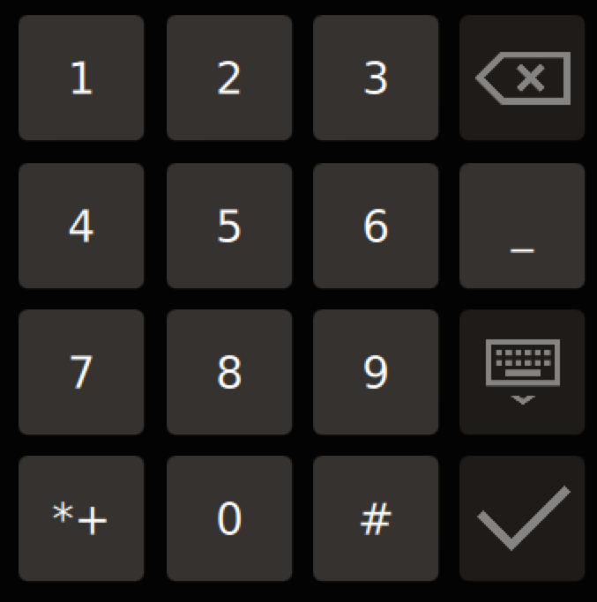
Usage
Configure and build the VKB from sources
lang-de_DE, lang-all – use ISO country and language codes
handwriting – by default enables T9 (if installed), use lipi-toolkit to enable lipi
disable-desktop – by default desktop VKB enabled on desktop platforms
Two VKB integration methods supported
Desktop – virtual keyboard is available for all applications without any changes in the apps
Application – virtual keyboard is available to applications only after the applications have created an instance of QML InputPanel element (only available integration method in Boot2Qt)
An application must load the VKB plugin either using QT_IM_MODULE environment variable or
Using qputenv(“QT_IM_MODULE”, QByteArray(“qtvirtualkeyboard”)); in main()

Slide 71
Settings – VirtualKeyboardSettings
Provides simple settings
Changing the style (retro, default, custom)
VirtualKeyboardSettingslocale.styleName = “retro”;
QT_VIRTUALKEYBOARD_STYLE environment variable may be used as well
The custom style is defined in QML using KeyboardLayout
Changing the locale
VirtualKeyboardSettingslocale.locale = “fi_FI”;

Slide 72
Essential Classes – InputPanel
InputPanel – Provides VKB UI
Anchor left and right or set width
Set y coordinate
Do not set height, as that is calculated automatically to keep the aspect ratio
Define, when visible
InputPanel {
z: 99
anchors.left: parent.left
anchors.right: parent.right
y: parent.height
visible: Qt.inputMethod.visible rent.right

Slide 73
Essential Classes – HandwritingInputPanel
Provides full screen handwriting input
Used together with InputPanel
Hides the input panel and shows handwriting keyboard, when made available (available: true)
Activated with active: true
UI logic is provided by the developer
HandWritingInputPanel {
id: hwInputPanel
anchors.fill: parent
inputPanel: inputPanelId
// Decoration to indicate the panel is active
Button {
anchors.fill: parent
onClicked: hwInputPanel.active = true;

Slide 74
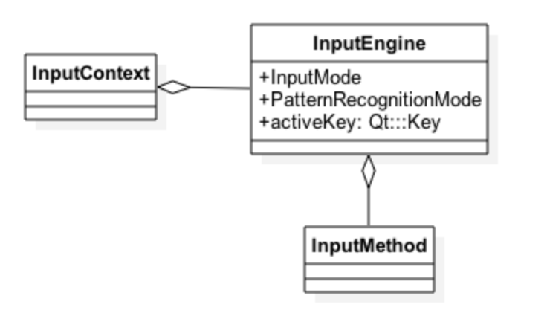
Essential Concepts
InputContext – Provides contextual information for the virtual keyboard and input methods
locale, inputMethodHints (ImhHiddenText, ImhDigitsOnly), pre-edit text, inputItem, cursor position, keyboard rectangle, input engine …)
if (InputContext.shift === true) { VirtualKeyboardSettings.locale = “fi_FI”; }
InputEngine – Provides an API to integrate input events
activeKey, virtualKeyPress, virtualKeyRelease, inputMode (latin, numeric, hangul, patternRecognitionMode)
Word selection model
Host for input methods (set the input method and it will start receiving keys from InputEngine)
InputContext and InputEngine are used as singletons

Slide 75
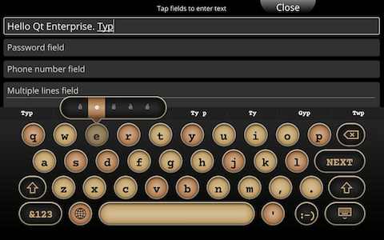
Essential Concepts
AbstractInputMethod/InputMethod – Base class for custom input methods
Create a custom input method type
Instantiate and assign to input engine
Set the input mode
InputMethod also provides access to locale-based layout virtualkeyboard/layouts/de_DE/symbols.qml

Slide 76
Customization – VKB Layouts
Layouts are provided in a locale-specific folder virtualkeyboard/layouts/de_DE/symbols.qml
Input mode defines the layout type, which is recognized by the file name
Some layout types are activated with input method hints (IMH) while other from the main layout
main, symbols, numbers (IMH), dialpad (IMH), handwiritng
KeyboardLayoutLoader {// Optional for managing several keyboard layouts (pages)
sourceComponent: Component { KeyboardLayout {
KeyboardLayout {
inputMethod: handWritingInputMethod // Only in HWR layouts
keyWeight: 200 // Decoration to indicate the panel is active
KeyboardRow {
Key { key: Qt.Key_A; text: “a”; alternativeKey: [ “ä”, “å” ] ]
BackspaceKey { weight: 400 ]
HandwritingModeKey { noModifier: true ]
TraceInputKey { patternRecognitionMode: InputEngine.HandwirtingRecognition ]
// Collects and renders touch input data

Slide 77
Customization – Styles
Defined in the virtualkeyboard/content/styles folder
Copy a default style folder
Replace images
Change the style.qml file
Set the resource prefix according to the location of your actual resources
Like “”, if in the same folder
Some stylable properties
Fonts
Icons
Icon scale
Background color
Margins
Key panel, containing a sound effect and control

Slide 78
Summary
Qt provides a cross-platform virtual keyboard for Linux, Boot2Qt and Windows
VKB can be used in the application and desktop mode
Application mode means InputPanel is created in code
Desktop mode is automatic
VKB supports easy localization and customization

Slide 79
Serial Bus

Slide 80
Contents
Serial Bus Usage
Backends

Slide 81
Qt SerialBus
Abstracts industrial serial buses and protocols
Controller Area Network (CAN)
Used mainly by automotive but also in cycling, industrial, and entertainment applications
Multi-master serial bus standard for connecting sensors and other control units
Units send and receive messages AKA frames to each other
ModBus
Request/reply protocol with one master and several slaves
Master reads and writes data into the slaves
Supports any QIODevice, provided the plugin implements QIODevice functions
Implemented in its own module
QT += serialbus

Slide 82
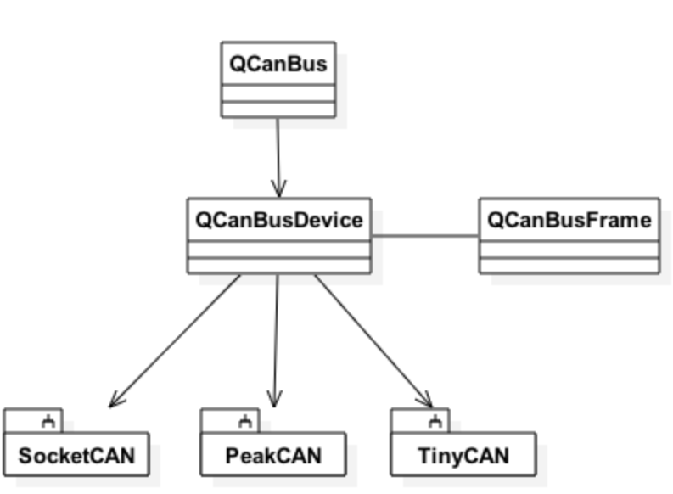
Serial Bus Usage – CAN Bus
The CAN bus API provides a common API + vendor-specific plugin
Two classes in the common API
QCanBusDevice – direct access to the CAN device
Reads and writes messages using the backend
QCanBusFrame – defines a message, which can be read or written to the CAN device
Provides an identifier, payload, and a timestamp, when the frame was read
Check the backend exists
Create the device
Set the configuration, if needed (bit rate (not supported in the CAN bus), frame filters etc.)
Read and write frames
Signal QCanBusDevice::framesReceived() emitted, when new frames received

Slide 83
CAN Bus Usage Example
Q_FOREACH (const QByteArray &backend, QCanBus::instance()->plugins()) {
if (backend == "socketcan") { // or “peakcan” or “tinycan”
// Plugin was found
break; } } // CAN interfaces, like can0, can be requested using ifconfig
// Peak can supports only USB adapters usbbus1 to usbbus8
// Tiny-CAN supports only two interfaces: channela and channelb
QCanBusDevice *device = QCanBus::createDevice("socketcan", QStringLiteral("can0"));
// Some configuration params, like bit rate, must be set before the connection
device->connectDevice();
QCanBusFrame frame;
frame.setFrameId(8);
QByteArray payload("A36E");
frame.setPayload(payload);
device->writeFrame(frame);
QCanBusFrame frame = device->readFrame();

Slide 84
CAN Bus Backends
Vendor-specific APIs are implemented in the backend plugin
Three backends supported
SocketCAN using Linux sockets and open source drivers
PeakCAN – using PCAN adapters
TinyCAN – using Tiny-CAN adapters
Use QCanBus to register and create bus backends
Create the CAN bus device: QCanBus::createDevice(const QByteArray &plugin, const Qstring &interfaceName)
Get a pointer to QCanBus singleton: static QCanBus::instance()
Return a list of loaded plugin identifiers: QCanBus::plugins();

Slide 85
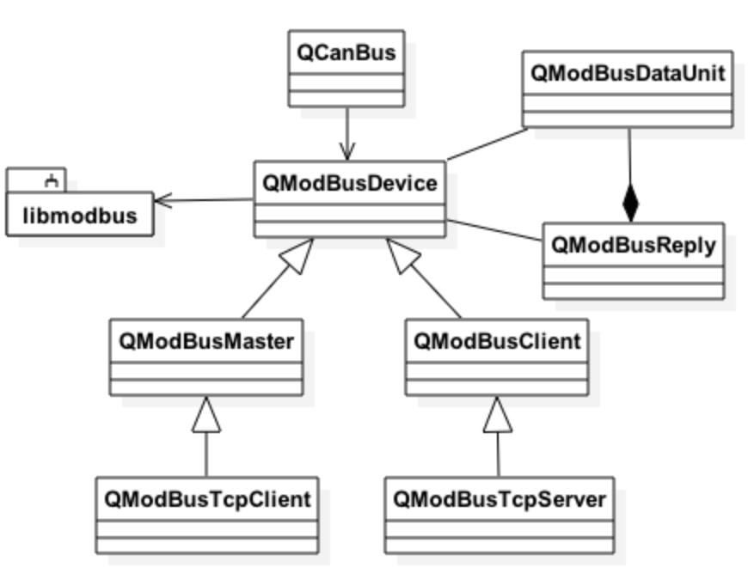
Serial Bus Usage – ModBus
QModBusDevice – QModBusMaster and QModBusSlave base class
QModBusMaster – Communicates with the backend using read()/write() functions
Subclass QModBusTcpClient
QModBusSlave – Direct access to ModBus slave
Subclass QModBusTcpServer

Slide 86
Serial Bus Usage – ModBus
QModBusDataUnit – Container, representing single bit or 16-bit entries in ModBus registers
Discrete Input and Coils are single bit register types
Several registers may be access from the start address and the number of contiguous entries
Input registers are read only as holding registers may be read and written
QModBusReply – Contains the data and address for the request
Signal finished() emitted after a request is successfully completed

Slide 87
ModBus Usage Example
Q_FOREACH (const QByteArray &backend, QCanBus::instance()->plugins()) {
if (backend == "libmodbus") {
// ModBus backend found
break;
}
}
// Create a master or slave, depending on the device
QModBusMaster *master = QModBus::createMaster("libmodbus");
// Initialize slave tables
modBusSlave->setMap(QModBusDevice::DiscreteInputs, 10);
modBusSlave->setMap(QModBusDevice::Coils, 10);
modBusSlave->setMap(QModBusDevice::InputRegisters, 10);
modBusSlave->setMap(QModBusDevice::HoldingRegisters, 10);

Slide 88
ModBus Usage Example
// Set a connection to the network and connect the device
// TCP uses QModBusDevice::TCP and serial port QModBusDevice::RemoteTerminalUnit
// package type, respectively
QSerialPort *serialPort = new QSerialPort("ttyS0");
modBusSlave->setDevice(serialPort, QModBusDevice::RemoteTerminalUnit);
modBusSlave->setSlaveId(1);
modBusSlave->connectDevice();
// Read or write a single or multiple data units units.append(QModBusDataUnit(QModBusDevice::HoldingRegisters, 3, 0x1af5)); units.append(QModBusDataUnit(QModBusDevice::HoldingRegisters, 4, 0x1001)); units.append(QModBusDataUnit(QModBusDevice::HoldingRegisters, 5, 0xff34));
modBusMaster->write(units);

Slide 89
ModBus Backends
One free SW backend library, libmodbus supported
Supports serial and Ethernet communication

Slide 90
Boot2Qt

Slide 91
Contents
Boot2Qt
Embedded App Creation, Building, Debugging, and Deployment
Build System Customization

Slide 92
Boot2Qt - Contents
Boot2Qt
Target Devices, actual HW
Qt Quick Controls
Boot to Qt Software Stack
Qt Libraries
QML apps
Additional Qt Add-Ons
Installer/Updater
Qt
Direct Device Deployment
SUPPORT
Linux Baselayer
Qt Creator
Embedded plugins
Enterprise plugins
…
Emulator
Linux Kernel
Boot to Qt Software Stack
Drivers
Custom HW
Reference HW
Embedded Linux

Slide 93
Boot2Qt - Value
Boot2Qt
Out-of-the-box device creation with Qt
Embedded Device creation has never been this easy!
Professional convenience and cost-effective tooling around Qt libraries
Run it on the device in just hours!
Boot to Qt Software Stack
Pre-built, lightweight, Qt-optimized software stack for embedded Linux
Custom HW support through The Qt Company
Qt Quick Controls
Qt Libraries
Additional Qt Add-Ons
Installer/Updater
SUPPORT
Qt Creator
Embedded plugins
Enterprise plugins
Emulator
Boot to Qt Software Stack
Custom HW
Reference HW

Slide 94
Boot to Qt Software Stack – Embedded Linux
The Embedded Linux variant provides exactly the same software stack than for Android but with different kernel
The Embedded Linux stack is built using Yocto recipes for Poky system
Boot to Qt Software Stack for Embedded Linux is Yocto compliant
Provides greater customization possibilities for the stack if one wants to replace parts of Boot to Qt
for instance custom WLAN component, etc.
The Qt Company helps in customization of the stack!
Boot to Qt Software Stack
QML apps
Qt
Linux Baselayer
…
Linux Kernel
Drivers
Embedded Linux

Slide 95
Supported Platforms and Toolchains
Raspberry Pi, Raspberry Pi 2
BeagleBone Black
Freescale SABRE SD i.MX6Dual, iMX6Quad
Boundary Devices i.MX6 Boards (QNX)
Toradex Apalis and Colibri i.MX6, Colibri VF
SILICA ArchiTech Tibidabo
Emulator
Any toolchain used for Linux building may be downloaded and used
Boot2Qt uses Yocto Poky reference system version 1.6

Slide 96
How to Get Started?
Pre-built target images and toolchains
Can be customized and built from the sources as well
Install Linux image to the SD card
sudo <Boot2Qt>/5.5/Boot2Qt/<device>-eLinux/images/deploy.sh /dev/<device>
Connect to the target using either Ethernet or USB
Android adb tool is used for device connection (Android Debug Bridge)
Ethernet
USB – the user account must have access to the plugged in devices
echo ‘SUBSYSTEM==“usb”, ATTRS{idVendor}==“18d1”, TAG+=“udev-acl”, TAG+=“uaccess”’ | sudo tee –a /etc/udev/rules.d/70-boot2qt.rules
Check the connection
<Boot2Qt>/Tools/b2qt/adb devices -l

Slide 97
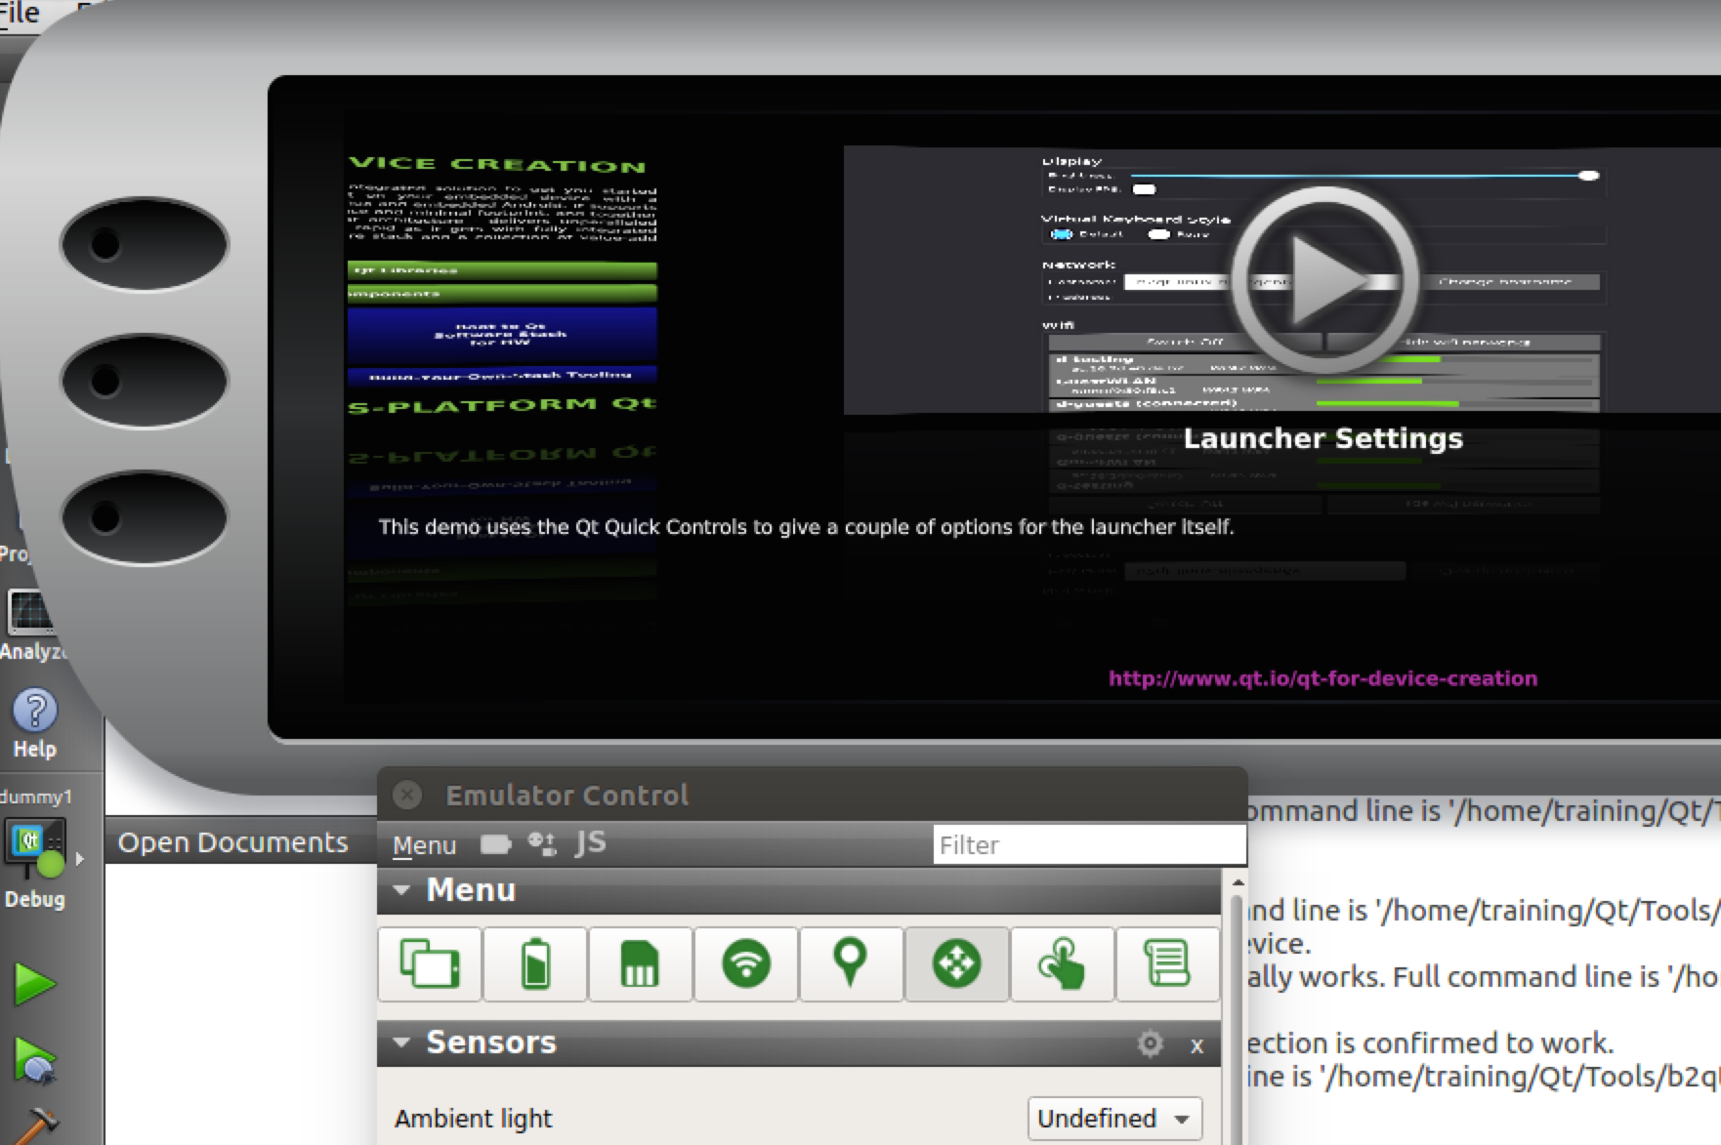
Emulator
Useful to run programs without the HW but with a similar configuration
Device model (dashboard, tablet, DPI)
Battery capacity, level, flow, voltage
SD storage
WiFi connection
Location (latitude, longitude, altitude, direction, speed)
Sensors(ambient light, orientation, compass, proximity)
Multipoint touches
Scripts

Slide 98
Creating Custom Builds
Install Qt Enterprise Embedded source packages using Qt binary installer
Install dependencies: gawk, wget, got-core, diffstat, unzip, p7zip-full, txinfo, gcc-multilib, build-essential, chrpath, libsdl1.2-dev, xterm, gperf, bison, curl, udisks, screen
Init Yocto
In the build folder, call
<Boot2Qt>/5.5/Boot2Qt/sources/b2qt-yocto-meta/b2qt-init-build-env init –device <device>
You may use list-devices option to see all the devices
Configure the build environment
export MACHINE=<machine>
source ./setup-environment.sh
Build the targets (Qt Enterprise Embedded contains two targets)
bitbake b2qt-embedded-image
bitbake meta-toolchain-b2qt-embedded-sdk
Note! No Qt libraries built yet

Slide 99
Creating Custom Builds
Build Qt libraries
Setup the build environment
<Boot2Qt>/5.5/Boot2Qt/sources/b2qt-build-scripts/embedded-common/init_build_env.sh
<Boot2Qt>/5.5/Boot2Qt/sources/b2qt-build-scripts/embedded/embedded-linux/config.<machine>
Build the libraries
Qt libs - ./build_qt.sh
Demos, add-ons, Qt WebEngine - ./build_extras.sh
Creates an image containing Qt libs in the rootfs /usr/local/ and the complete image to be deployed to the target - ./build_image.sh
Copy the image to the SD card
sudo ./deploy.sh /dev/<dev_name>
Add a new kit to QtCreator
<Boot2Qt>/5.5/Boot2Qt/sources/b2qt-build-scripts/embedded-common/setup_qtcreator.sh

Slide 100
Summary
Boot to Qt provides pre-built binaries for many embedded targets
Possible to concentrate on app development starting from day 1
Possible to configure and build the root file system and Qt libraries for custom platforms as well
Emulator allows SW testing without the actual HW
Can be configured to have similar features to target HW
Deployment and on-device debugging are supported by QtCreator

Slide 101
Thank you
NN@qt.io

